Slide 1
Case Study 3: Wealth Over Time
Group 3: Candice Kasahara, Yvonne Huang, Eshan Ul Hoque Tanim

Slide 2
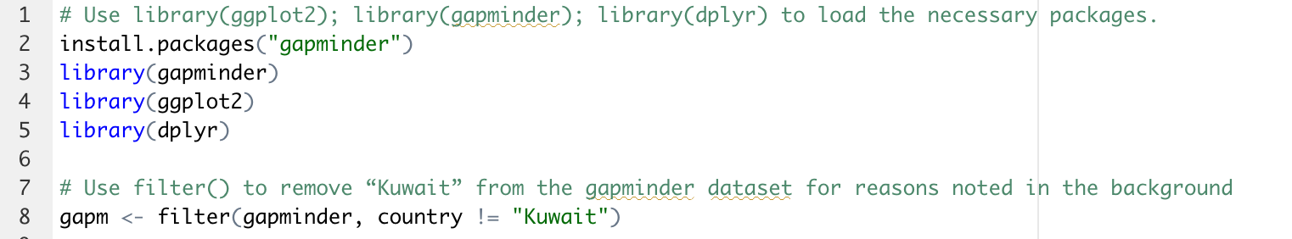
Download Packages and Filter
“gapm” contained 1,692 observations of 6 variables

Slide 3
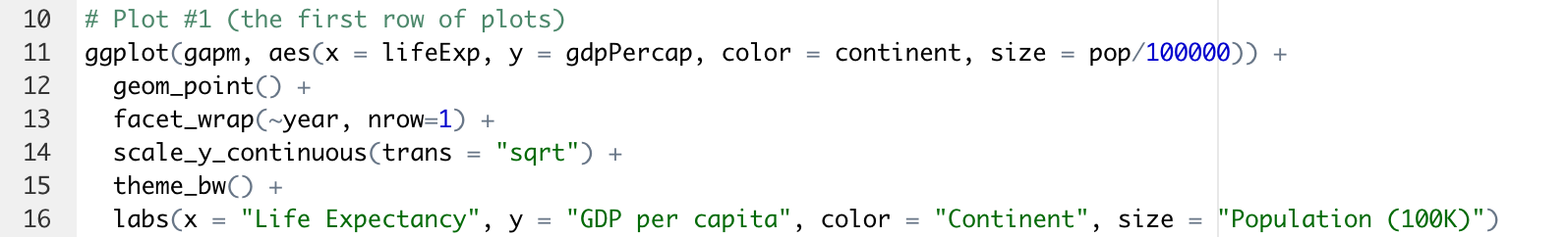
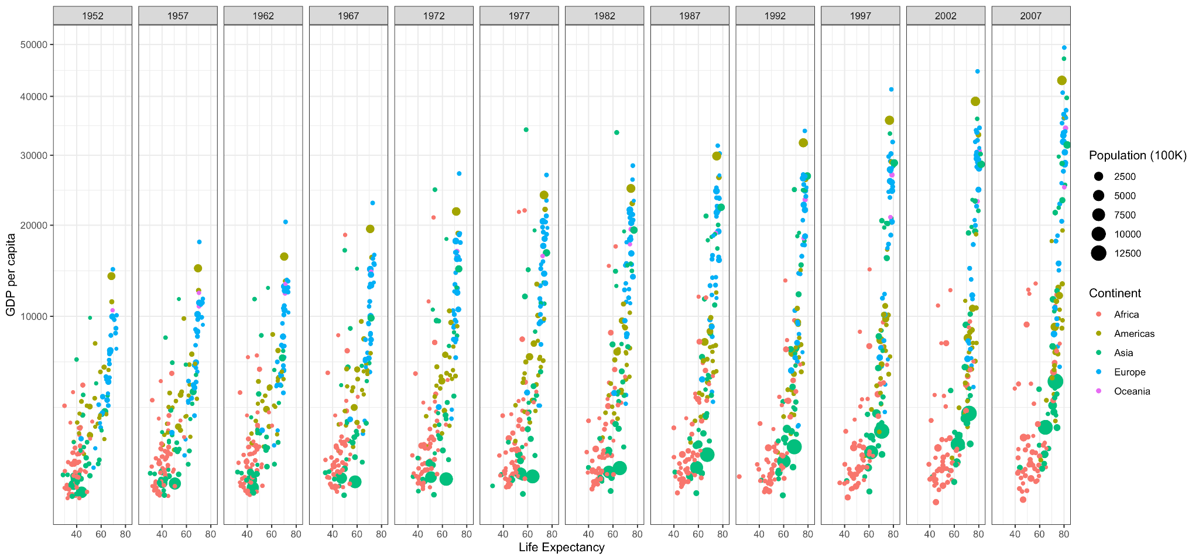
Plot 1: Life Expectancy vs. GDP per capita

Slide 4
Group and Summarizing for Plot 2
Used the data frame “gapm” again to exclude Kuwait from the plot
“gapminder_continent” groups the data by continent and year
“gapminder_continent” summarizes the mean gdpPercap and population

Slide 5
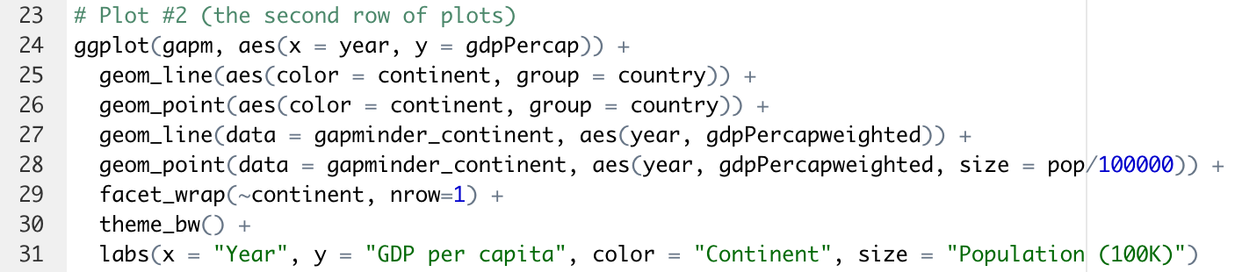
Plot 2: GDP per capita over time
Applied “gapminder_continent” data frame to an additional geom_line and geom_point to show the average trend

Slide 6
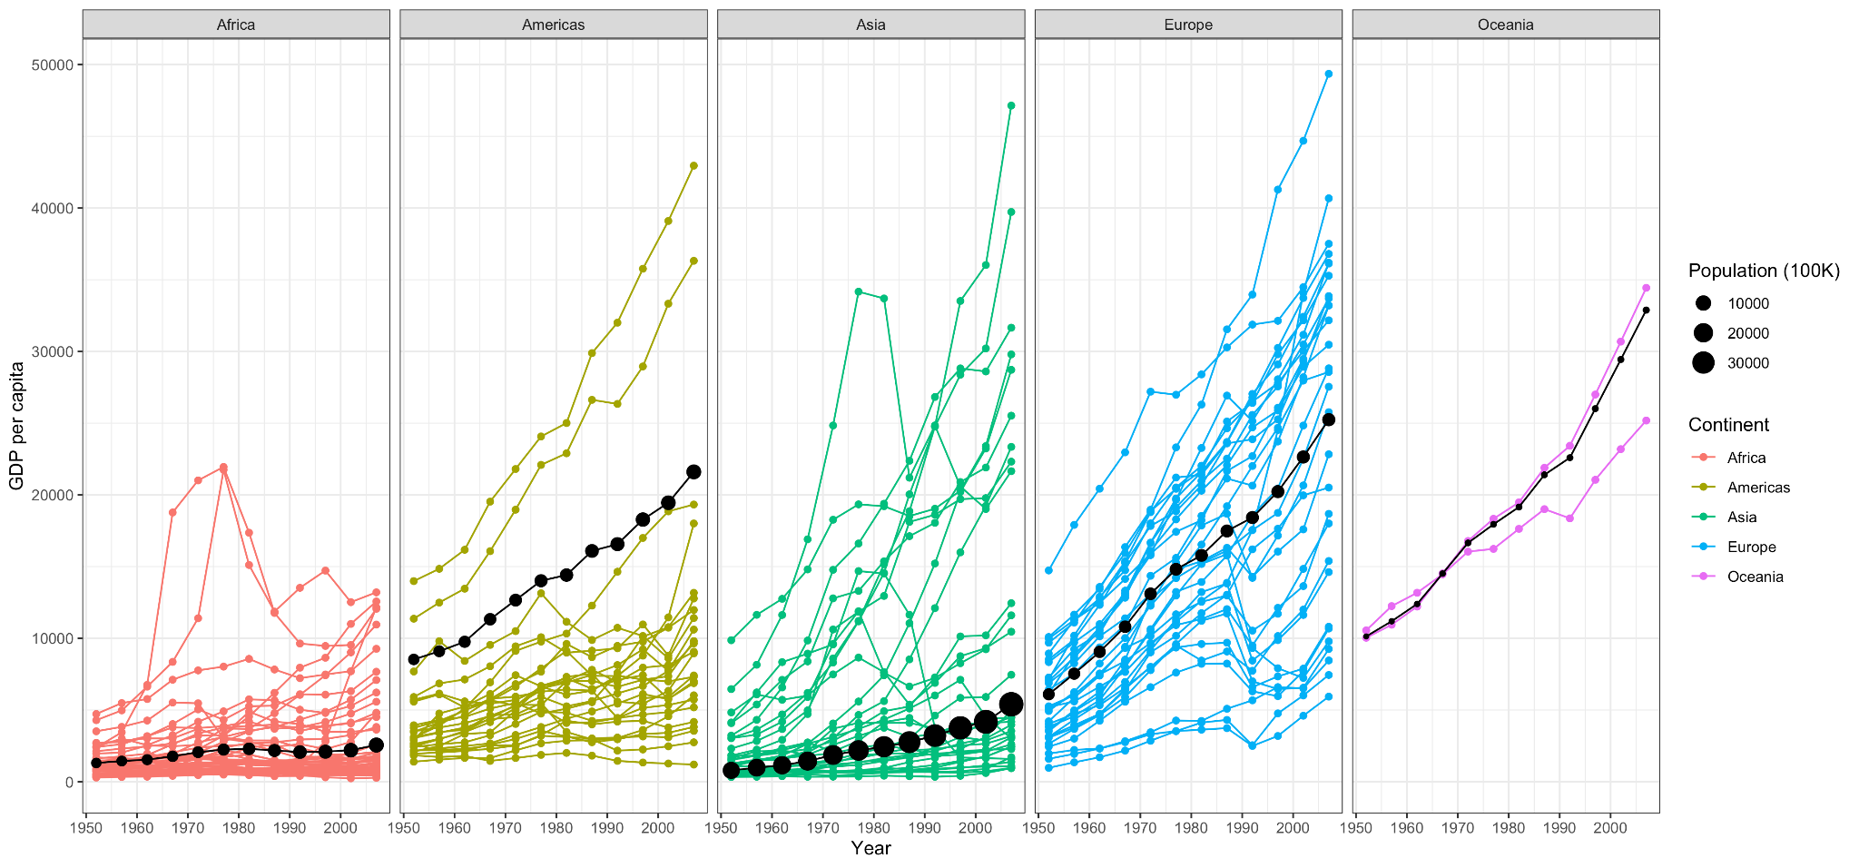
Plot 2: GDP per capita over time

